Slide 1

Intelligent Systems in Gaming
By: Joshua Bleeker
Notes:
Hello my name is Joshua Bleeker and I will be presenting about Intelligent Systems in Gaming. One thing to note is that I will be using the term AI and and Intelligent System interchangeably even though they aren’t exactly the same thing

Slide 2
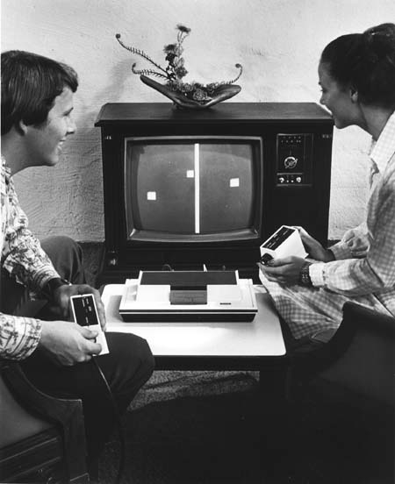
History
AI first appeared in games in 1950s
AI in gaming took off in 1970s
Sports games adopted AI in 90s
2000s brought RTS games among others
Notes:
Twenty years before the infamous Pong video game came out, artificial intelligence was being used in computerized games. One of the earliest examples is the 1951 mathematical strategy game Nim, in which two players take turns to remove objects from piles.
By the 70s AI in gaming really began to come into its own.
1978s space invaders had increasingly difficult levels and distinct movement patterns that would change dynamically depending on the input of the player
In 1980 Pac-Man introduced AI patterns to its maze. AI also enabled the game’s ghosts to have different personalities.
In 1984’s fighting games began using AI so that if someone wanted to play alone they would have a computer to play against.
By the 90s sports games like the Madden and Tony La Russa Baseball let you play against a team that is actually running plays and ‘strategizing’
Formal AI tools like finite state machines were used for the new video game genres that emerged in the 1990s. For instance, AI was used in real-time strategy games for pathfinding problems, making real-time decisions, and economic planning.
By 2005 Façade introduced interactive multiple-way dialogs

Slide 3
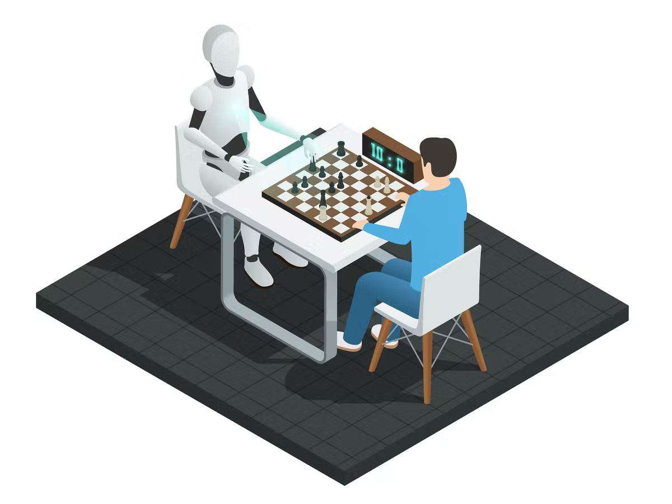
Why do games need AI?
Games learn over time
Gives Games Realistic Feel
Varied Gaming Experiences
Saves Money and Time
AI Takes Gaming To New Heights
Notes:
With the help of AI, game developers are coming up with new techniques like reinforcement learning and pattern recognition. These techniques will help the game characters evolve through self-learning of their actions. A player will notice a vast difference when they play a game in the AI environment. Left 4 Dead 2’s game director is in my opinion the single most impressive and well done intelligent system in gaming history. The game director’s job is to assess how the current player is doing in the level and adjust the difficulty, the way the map is laid out, how much ammo and health you get, how many enemies are thrown at you and where they come from, etc. Having played the game for my entire life I can say that it is extremely engaging and keeps me coming back after all of these years.
When talking to an AI entity or companion in a video game a believable and realistic response is key. Let’s say you’re playing a role playing game and you just we committed a horrible crime, all of the townsfolk should respond with negatively. Your actions can feel if the world does not respond in a believable way.
When making a game it is key to make sure that the game has replay value. There is no better way than to do this with AI. A good example of this is a game called warframe. Each planet in the game will have a similar look and feel, and all the assets will be pulled from the tileset made for that planet. But almost every level in the game will be procedurally generated so that it is unique every single time.
Intelligent systems in gaming save countless hours and dollars. Instead of paying numerous other developers, one person can make an amazing game given they develop or can get their hands on the correct resources. For example: if one single developer can master procedural generation and tools like it they can make a game have an infinite amount of varied levels, which is something that 100s developers couldn't do without AI.
AI also lets developers take games to new heights. With AI developers can greatly increase the scope of the game

Slide 4

Issues with Intelligent Systems
Microtransactions
Unfair Difficulty
Can be unrealistic
Notes:
Unfortunately, most of the time game developers are at the mercy of their publishers because the publishers are the people signing their paychecks. Often times the publishers are pressured by the shareholders to maximize profits which often times means implementing intelligent ways extort their player base and squeeze every last dime out of them.
Another potential issue with Intelligent systems in gaming is that if the devs aren’t careful they can develop a system that is unenjoyable to play against or even sometimes just impossible. A good example of a recent game that was too difficult is Back 4 Blood. In this game the hardest difficulty was very near impossible to enjoy, while it was ‘possible’ to beat it took coordination from 4 absolute experts to beat it. The devs have since toned it down with an update but they have definitely lost some of their player base due to this.
When devs trust their game to learn from and about the player to change the world around them they might not always know what the player wants. The AI does not know how to process emotion in any way to it is up to the devs to program the intelligent system to predict how the player is supposed to feel. If done incorrectly it can lead to unrealistic and unintended bugs that can break the players immersion pull them out of the game.

Slide 5

Intelligent Solutions
The law has cracked down on microtransactions
Difficulty can be tuned correctly
AI will learn to be more realistic
Notes:
While microtransactions ran wild in the gaming world for a couple of years, more recently the world has taken notice and taken action. In 2018, the Federal Trade Commission (FTC) began its investigation into video game loot boxes, which immediately resulted in many developers shying away from the practice. Australia has also taken strong action against random loot boxes either banning games that featured them or forcing the developers to change them.
Difficulty is can be well, difficult. Tuning the difficulty not to be too easy for the experienced players and not to be too hard for the casual player is a real challenge. An approach that games have been using for a very long time is offering multiple difficulty levels. Even in the Back 4 Blood example listed in the last slide if you really wanted to you could just play on an easier difficulty level. The only issue is that the hardcore veterans might hurt their pride playing on a difficulty other than the hardest one.
As the industry grows and the skills of the devs continue to develop AI will be taught to be more and more realistic.

Slide 6

Notes:
In conclusion intelligent systems in games are really beneficial and the games industry would not be where it is without today without them. While their are some kinks and issues that come along with them, the benefits highly outweigh the negatives.

Slide 7
Works Cited
How artificial intelligence will revolutionize the way video games are developed. insideBIGDATA. (2020, November 28). Retrieved February 15, 2022, from https://insidebigdata.com/2020/11/27/how-artificial-intelligence-will-revolutionize-the-way-video-games-are-developed/
Bigdata. (2021, March 24). History of AI use in video game design. Big Data Analytics News. Retrieved February 15, 2022, from https://bigdataanalyticsnews.com/history-of-artificial-intelligence-in-video-games/
Hassan, A., &amp; Ali Hassan (25 Articles Published) Ali is a gaming journalist that has focused his effort on writing feature articles. He's from the land down under and is studying a dou. (2021, February 26). How in-game microtransactions became such a widespread problem. ScreenRant. Retrieved February 15, 2022, from https://screenrant.com/video-game-microtransactions-lootboxes-pay-win-lawsuit-regulation/
Craig. (2017, May 29). True AI could ruin video games, Not make them better. Medium. Retrieved February 15, 2022, from https://medium.com/@CRA1G/true-ai-will-ruin-video-games-not-make-them-better-244cc786ac55

